Slide 1
Playbooks Foundations

Slide 2
Agenda
What is Playbooks?
Playbooks Makes Sales Easy!
Setting Up Playbooks
Recommended Settings

Slide 3
What is Playbooks?

Slide 4
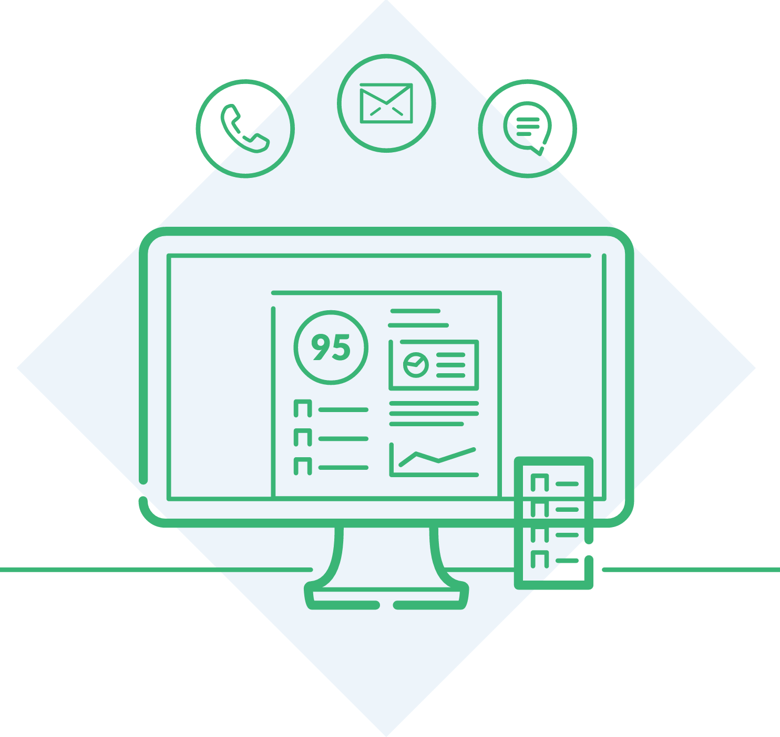
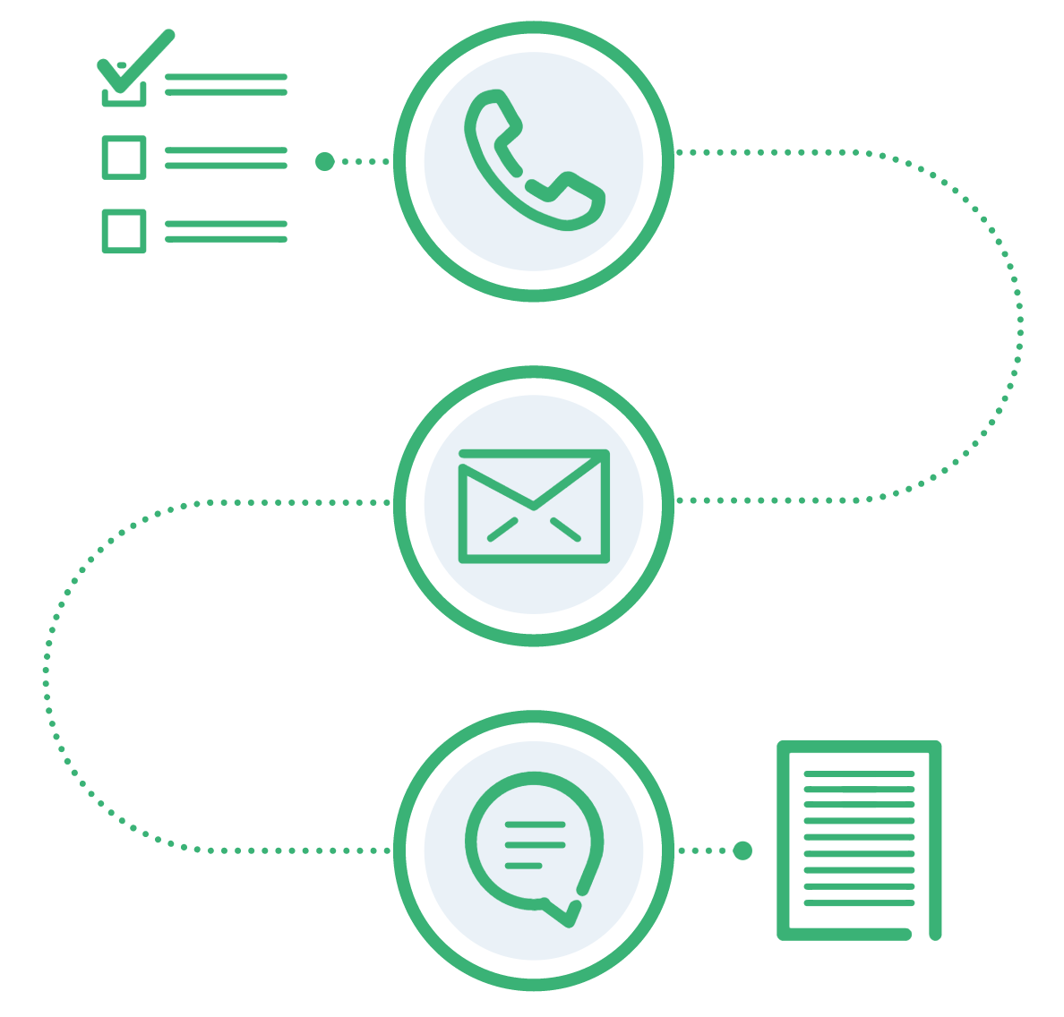
Why Playbooks?
1
2
Streamlined Workflow
Remove guesswork about the what/when of your next step
Outreach Strategy
Automated Cadence &
Outreach Best Practices
Notes:
Use case studies to show what we deliver.

Slide 5
What is a Play?
A Play is a sequence of pre-defined outreach attempts that help you progress through the sales cycle.
They provide call cues and content to help accelerate your effort and identify what’s working with your prospects

Slide 6
Playbooks Makes Sales Easy!

Slide 7
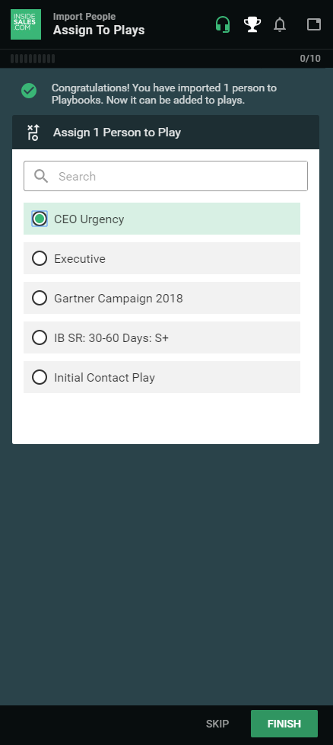
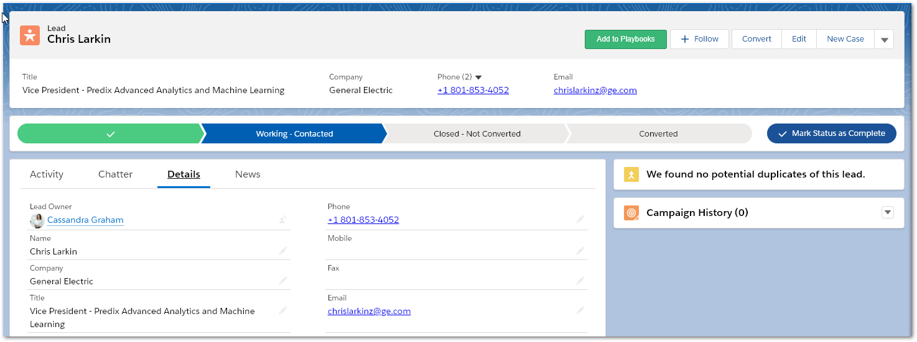
Assign a single record to Play
Open Record
Click “Add to Playbooks”
Select a Play
Click Finish
Notes:
Best Clicpractice for any new records not currently in Salesforce is to add them in the CRM first and then import to Playbooks.
You will only be able send emails from Playbooks once the person is in enrolled in a Play.
You still can call it via the Playbooks k to Call in Salesforce

Slide 8
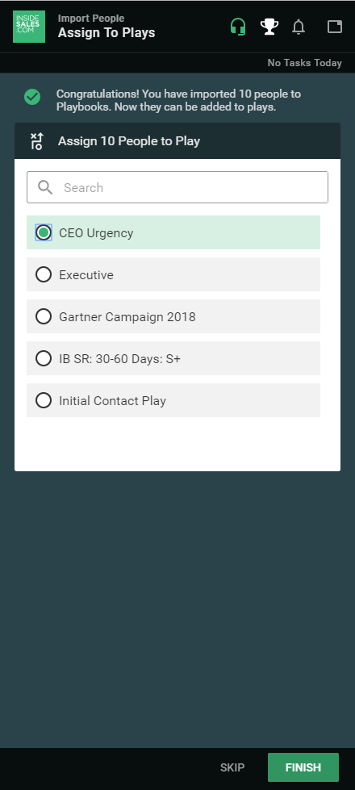
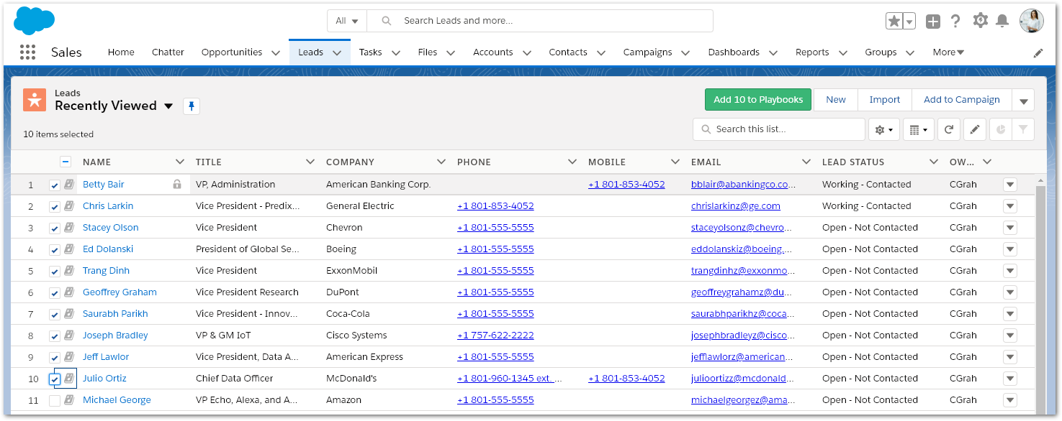
Assign multiple records to Play
Select Records in a List View or Report
Click “Add to Playbooks”
Select a Play
Click Finish
Notes:
Best Clicpractice for any new records not currently in Salesforce is to add them in the CRM first and then import to Playbooks.
You will only be able send emails from Playbooks once the person is in enrolled in a Play.
You still can call it via the Playbooks k to Call in Salesforce

Slide 9
Playbooks Dashboard
Easily see your Call and Email tasks due today
Then quickly jump to the first task for the day

Slide 10
Making a Phone Call
My first task is to call Chris Larkin at General Electric
My manager has provided me with some prompts to assist on my call
I can select the best number to reach Chris
When I am ready to call I just click “Dial”

Slide 11
Making a Phone Call
When I click “Dial”, my desk phone will ring
I answer it, and the call begins ring out to Chris
Chris answers, and we have a great conversation
When we are through, I click “End” to hang up the call

Slide 12
Making a Phone Call
After ending the call, I disposition it as a Correct Contact
Write a few notes
Then click “Save”

Slide 13
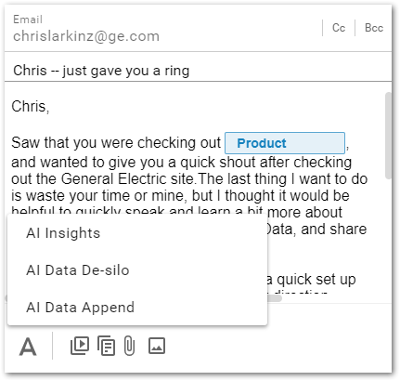
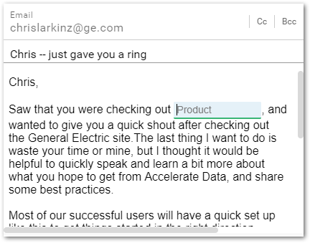
Sending an Email
My next step is to send Chris an email
An email template is populated for me to customize
AI Insights
Clicking Send will schedule the email to be delivered at the ideal time

Slide 14
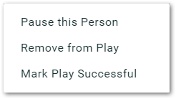
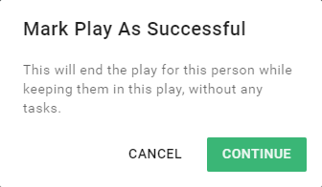
Marking a Play Successful
Success means that I completed the goal of my Play
When I mark the Play Successful, the Success status syncs
back to Salesforce
My manager uses successful plays to identify what is working and what is not

Slide 15
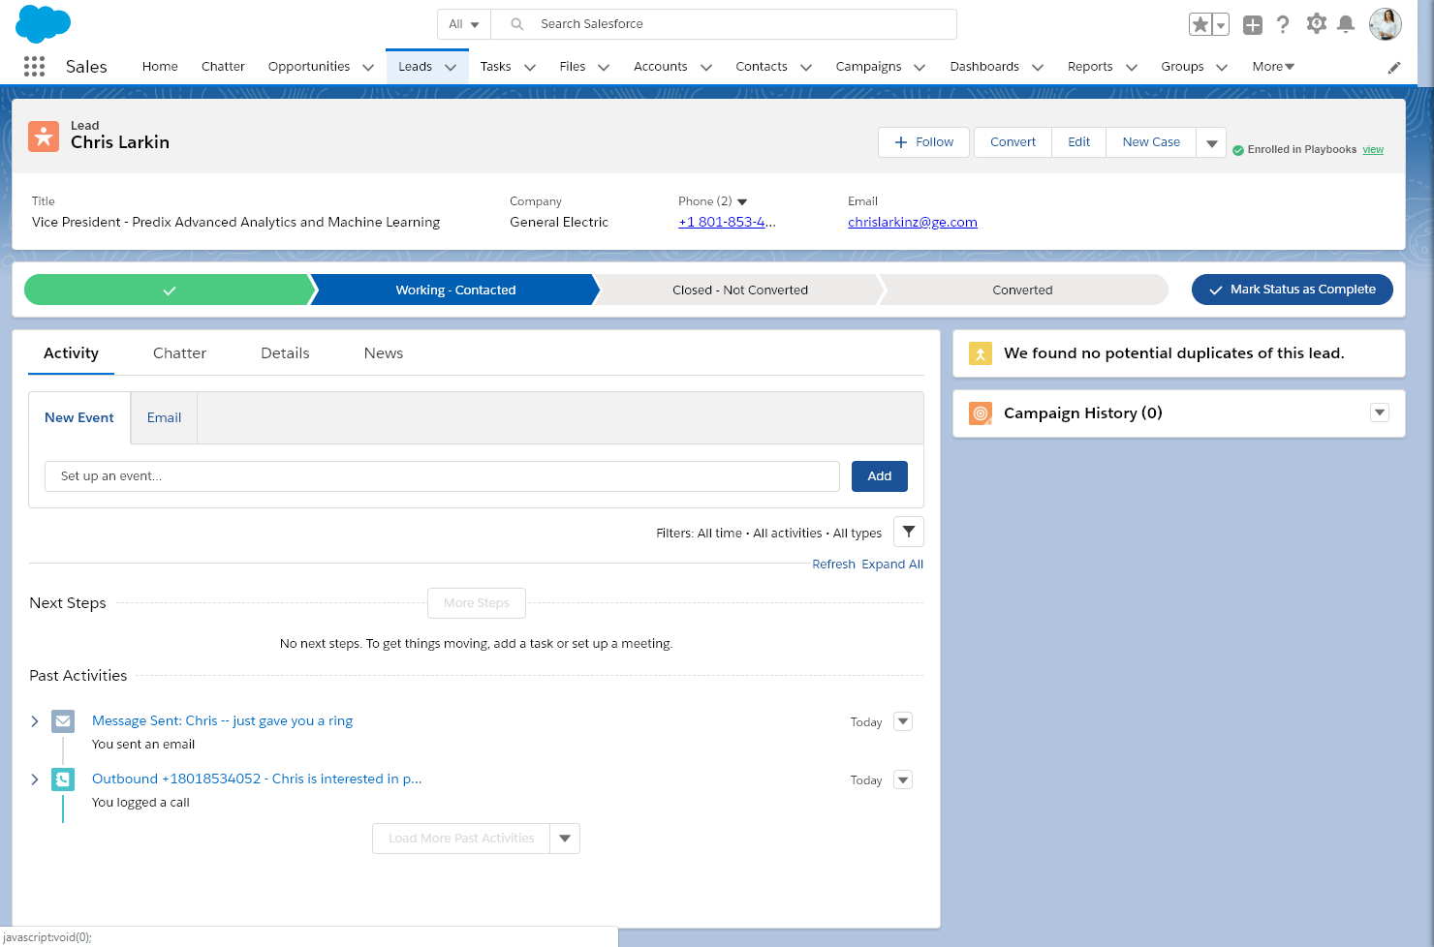
Activity History
Playbooks automatically syncs all of my activities to Salesforce.
Here I can see my call and email that I just sent to Chris!

Slide 16
Setting Up Playbooks

Slide 17
Make Chrome the Default Browser
In Chrome, go to the Menu (three dots) in the top right corner.
Go to Settings
Scroll down and click “Make Default” in the Default Browser Section

Slide 18
Installing the Playbooks Extension
In Chrome, go to https://tinyurl.com/isdcplaybooks
Click on ‘Add to Chrome’ button

Slide 19
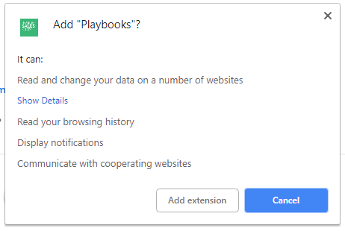
Installing the Playbooks Extension
Click ‘Add extension’
Playbooks is now ready for use!

Slide 20
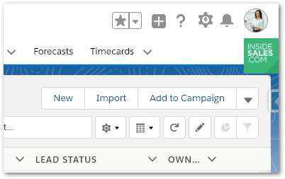
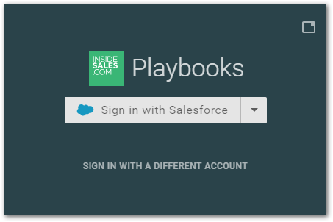
Installation Complete!
The Playbooks plug-in appears on top of Salesforce
Click this button to sign into Playbooks with Salesforce

Slide 21
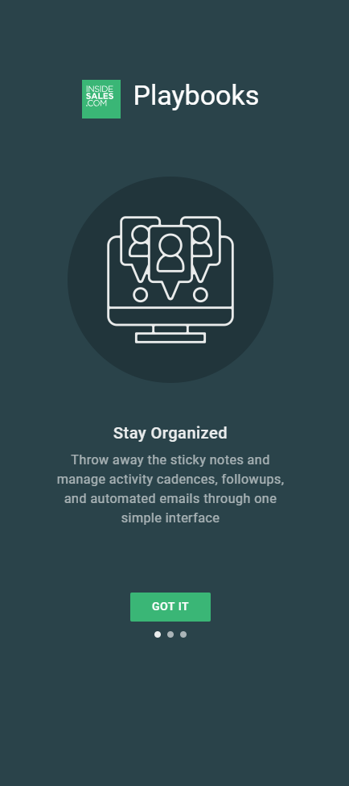
First Time User Experience

Slide 22
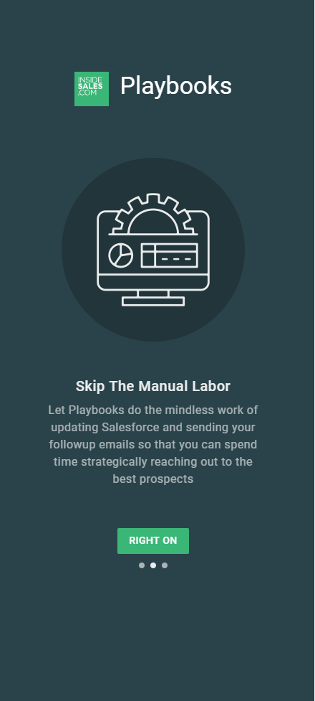
First Time User Experience

Slide 23
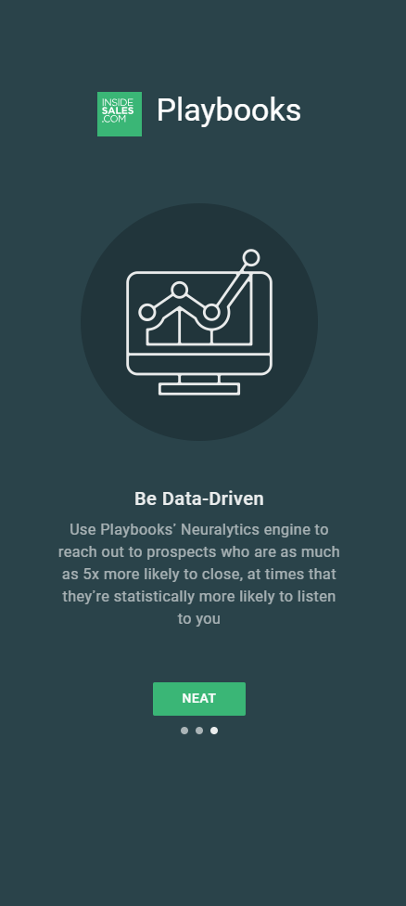
First Time User Experience

Slide 24
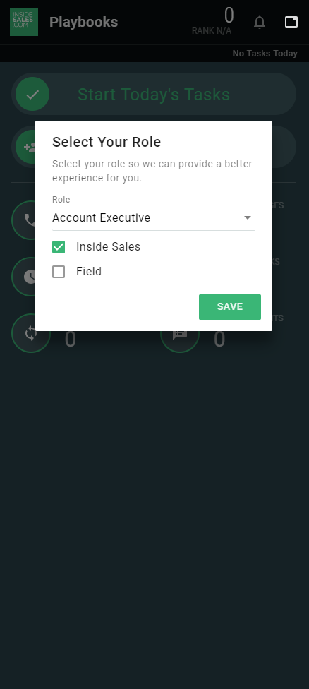
First Time User Experience
Set your Role:
Account Executive
Inside Sales

Slide 25
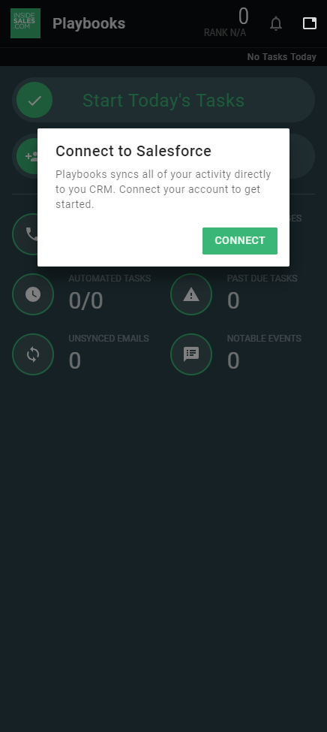
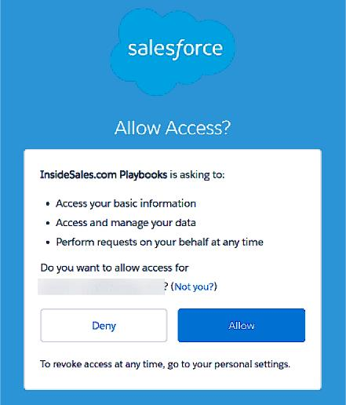
First Time User Experience
Click “Connect”, to connect Playbooks to Salesforce
When prompted in the popup window, click “Allow”

Slide 26
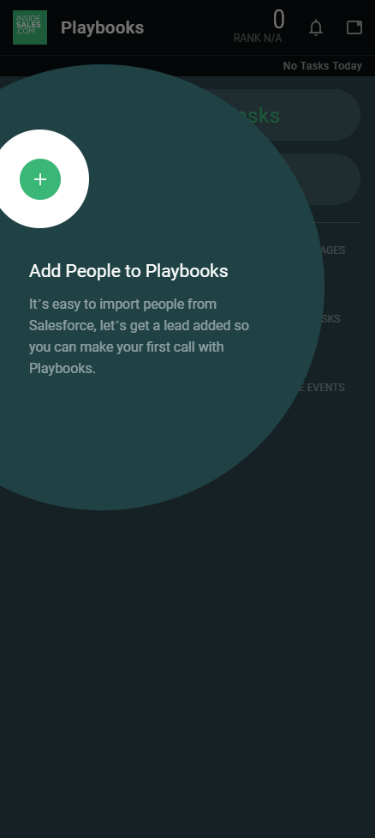
First Time User Experience
Click the plus sign

Slide 27
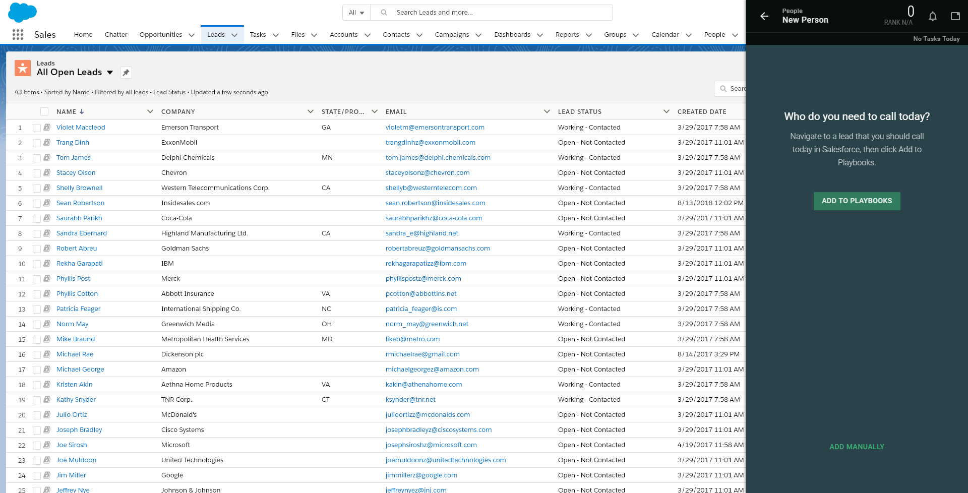
First Time User Experience
Add some people that you need to call today

Slide 28
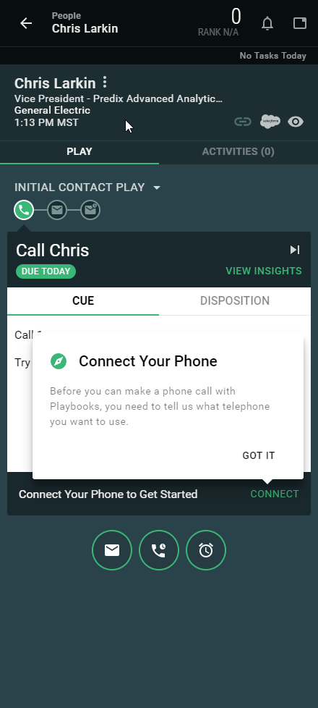
First Time User Experience
Add your desk phone number
Then, begin working the people that you just added
Playbooks will guide you through the steps

Slide 29
Recommended Settings

Slide 30
Additional Settings

Slide 31
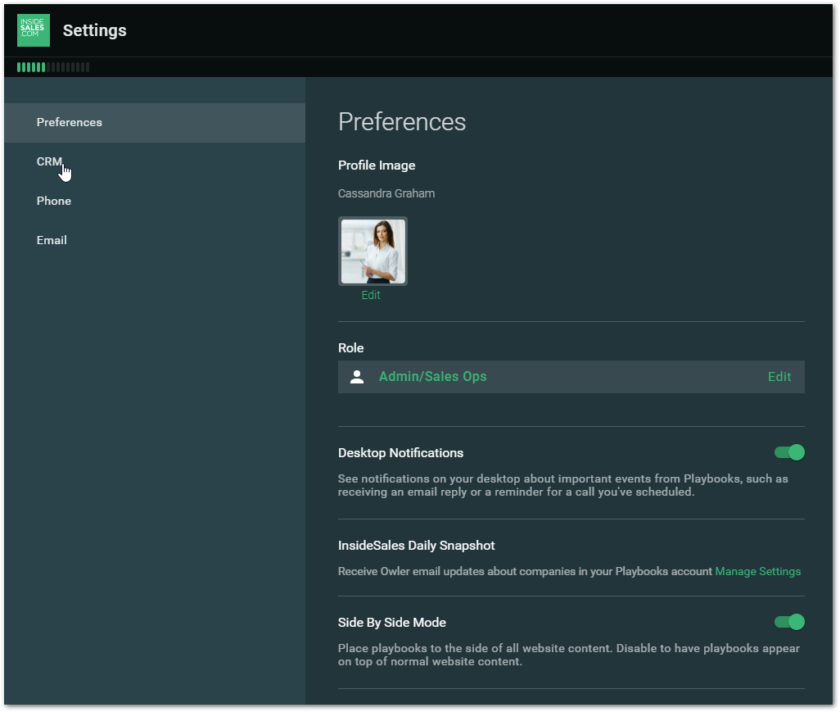
Additional Settings
Enable Desktop Notifications
&
Enable Side By Side Mode

Slide 32
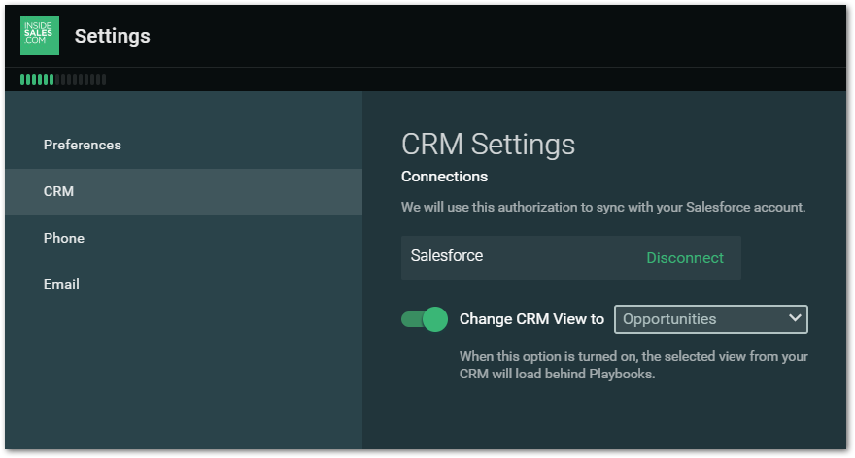
Additional Settings
Enable Change CRM View
&
Select Opportunities

Slide 33
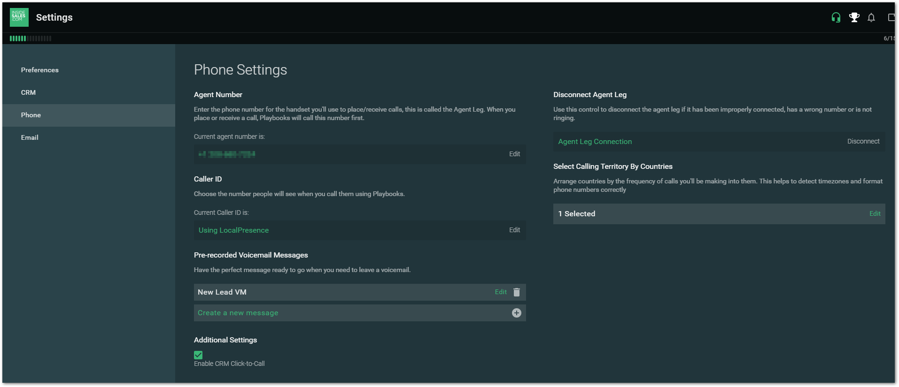
Additional Settings

Slide 34
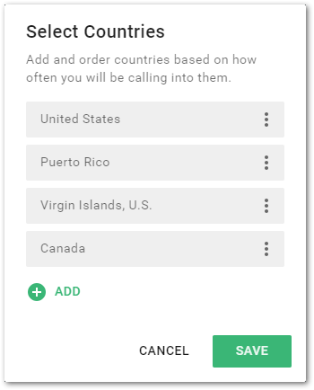
Additional Settings
Add the Countries that you generally call into
The United States should be first if you call into the US

Slide 35
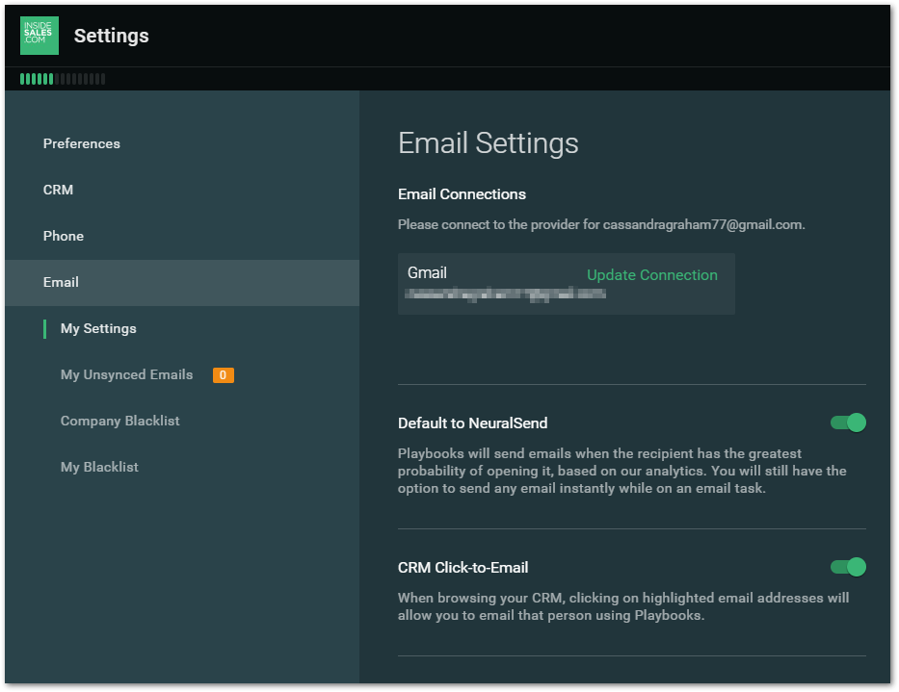
Additional Settings
Enable Default to NeuralSend
&
Enable CRM Click-to-Email

Slide 36
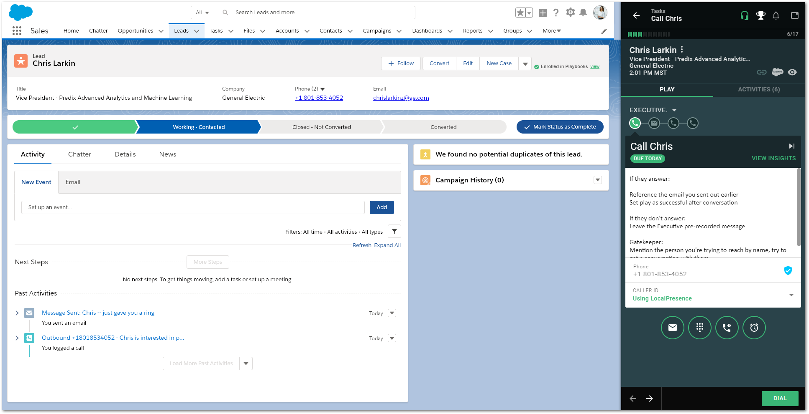
Welcome to Playbooks

Slide 37
Advanced Playbooks

Slide 38
Agenda
Additional Call Features
Additional Email Features
Scenarios
Resources

Slide 39
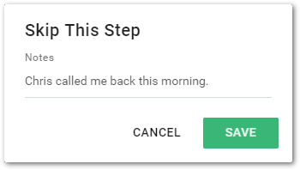
Additional Call Features
Skip A Step
If I have already spoken to Chris today, I may not need to call again

Slide 40
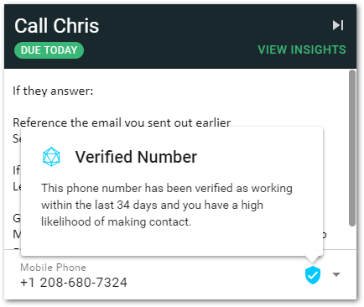
Additional Call Features
NeuralVerify
See what phone numbers or email address are best (or worst)

Slide 41
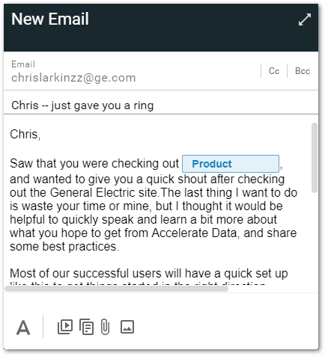
Additional Call Features
Send an Ad-Hoc Email
If I want to send Chris an email that is not part of the Play, I can do that here

Slide 42
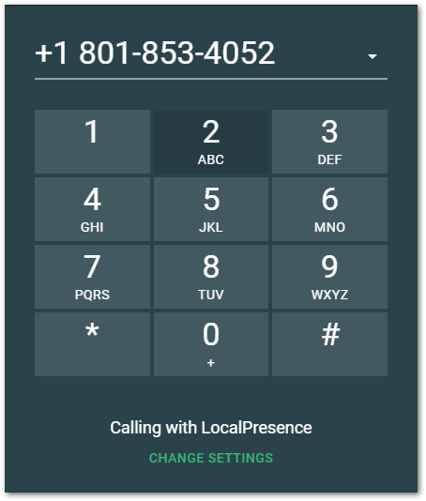
Additional Call Features
Select from all available phone numbers
Make an Ad-Hoc Call
If I want to call additional numbers, I can make Ad-Hoc calls

Slide 43
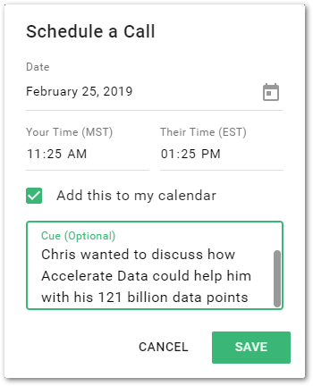
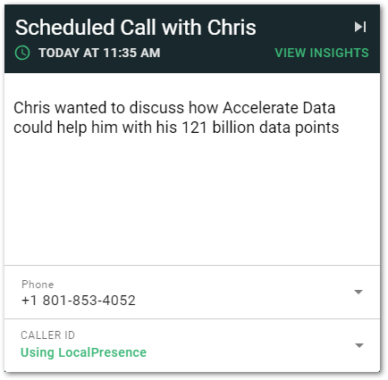
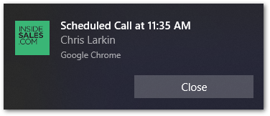
Additional Call Features
Select the
Date and Time
(your time or theirs)
Add this event to your calendar
A short note to yourself to remind you the purpose of the call
Schedule a Call
If Chris tells me to call at a certain day and time, I can schedule that event and Playbooks will remind me of it

Slide 44
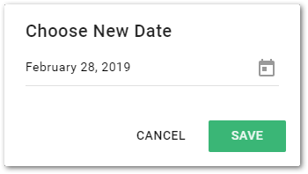
Additional Call Features
Snooze the Task
If Chris is on vacation for instance, I can reschedule this step until he returns

Slide 45
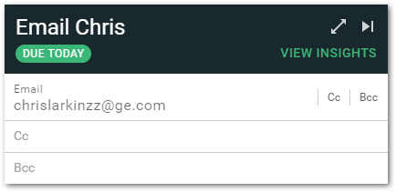
Additional Email Features
Add CC or BCC

Slide 46
Additional Email Features
Customize Text Formatting

Slide 47
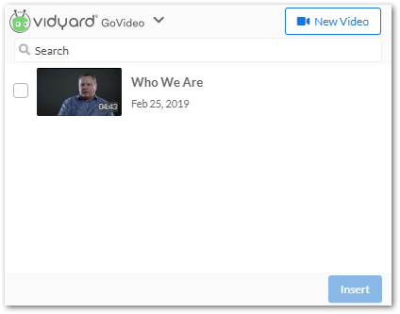
Additional Email Features
Create A Video
(Upload or Record)
Select the video to use
Insert it into the email
Add Video to Emails

Slide 48
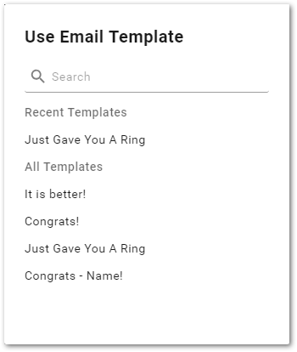
Additional Email Features
Select a Template

Slide 49
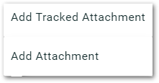
Additional Email Features
Tracked Attachments will tell you when the content was accessed
Add Attachment can be used if you do not need notifications
Add an Attachment

Slide 50
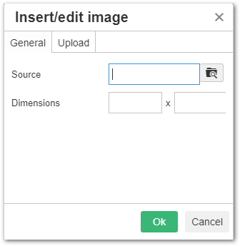
Additional Email Features
Select your image here
Insert an Image

Slide 51
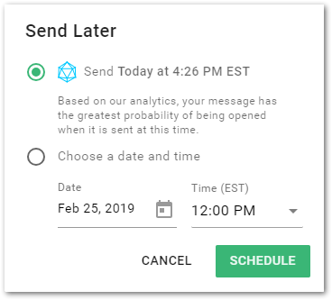
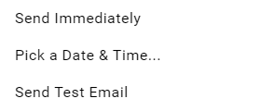
Additional Email Features
Schedule the Email or Send Immediately

Slide 52
Playbooks for Outlook
X
Track any email you send, and sync it to your CRM

Slide 53
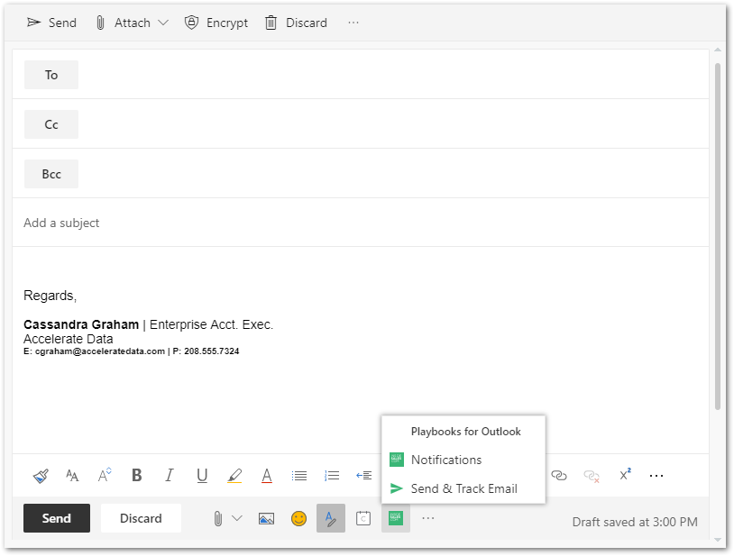
Playbooks for Outlook
X
Track any email you send, and sync it to your CRM

Slide 54
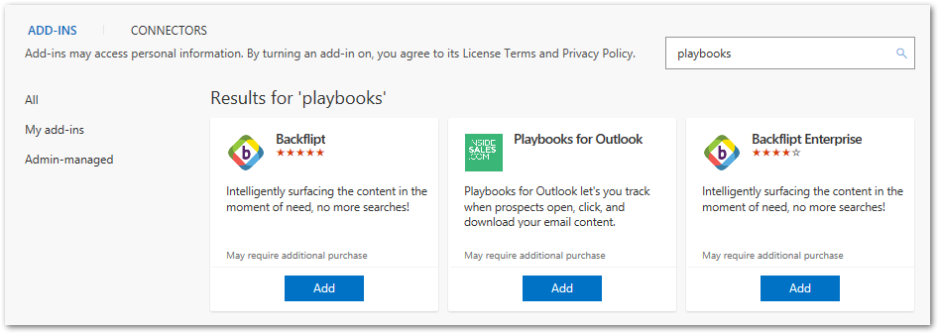
Playbooks for Outlook - Setup
In Outlook, go to “Get Add-ins”
Search for “Playbooks”
Click “Add”

Slide 55
Creating Email Templates

Slide 56
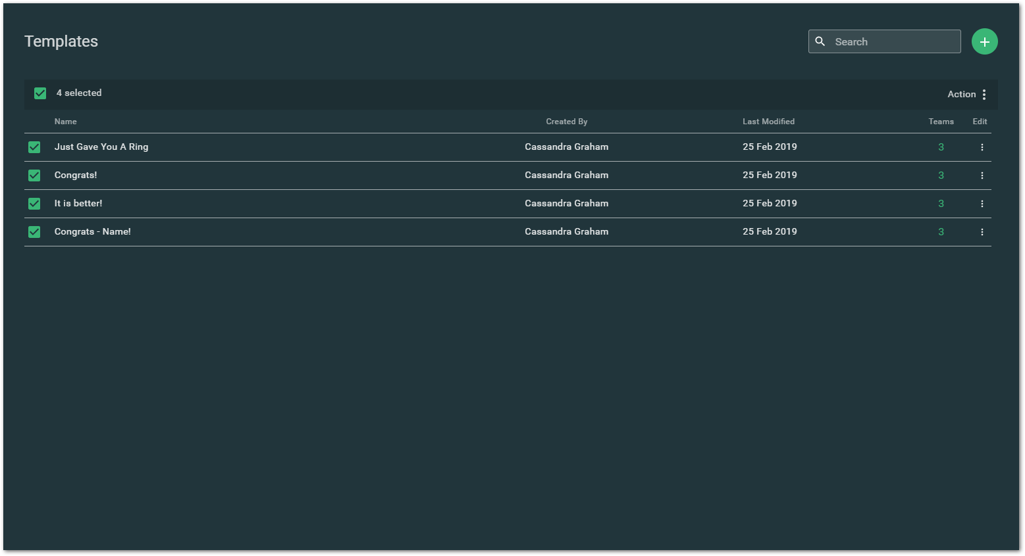
Creating Email Templates

Slide 57
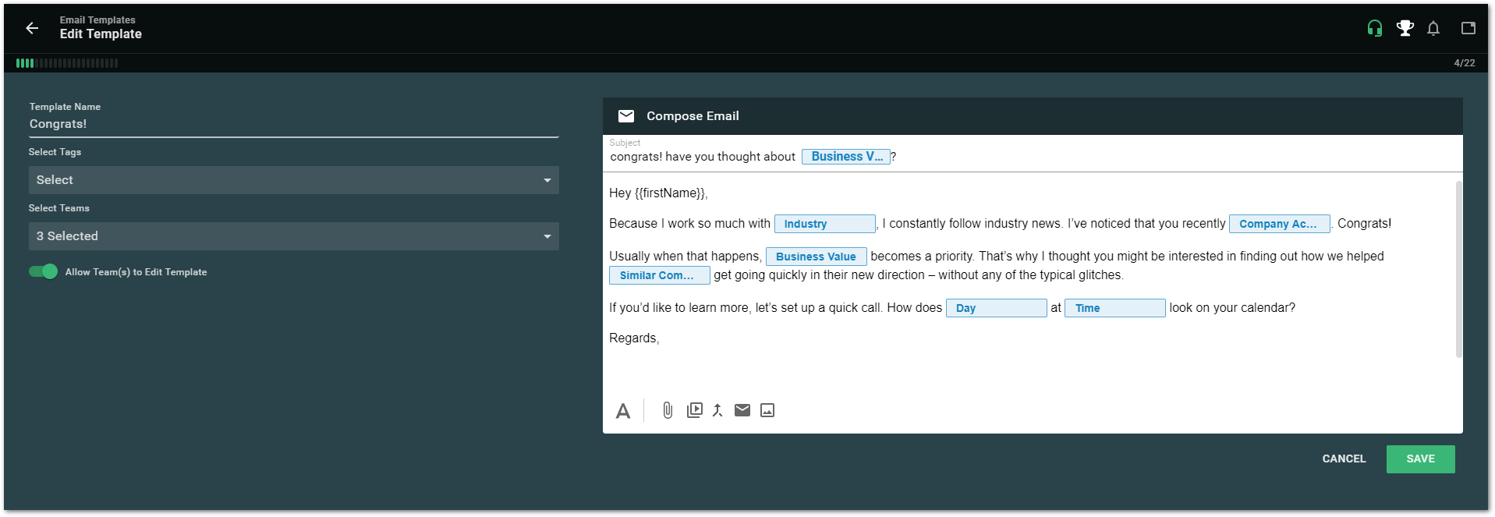
Creating Email Templates
Merge fields and Placeholders are available here

Slide 58
Notification Feed
Playbooks will notify you if…
You have a Scheduled Call
An email sent via Playbooks is opened
A tracked attachment is downloaded
A hyperlink is clicked in an email
Clicking a notification will load that record in Playbooks

Slide 59
Why use voicemail?
66% of executives say they are likely to respond to voicemail
80% of callers sent to VM don’t leave messages
Most sales teams over-rely on email, as opposed to delivering value in multiple mediums
Notes:
Source: http://www.insidesales.com/ebook/cold-call-voicemail-and-email-strategies-that-work-confirmation

Slide 60
Why voicemails fail
On average, VMs have 4.8% response rate – why not more?
Preparation - Sales rep is not prepared
Objective - There is no clear objective of the voicemail
Message - The message is not compelling enough to solicit a response
Practice - Sales rep has not practiced
Duration - the Voicemail is simply too long (longer than 25 seconds)
Notes:
Source: http://www.insidesales.com/ebook/cold-call-voicemail-and-email-strategies-that-work-confirmation

Slide 61
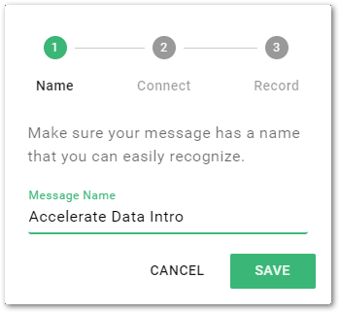
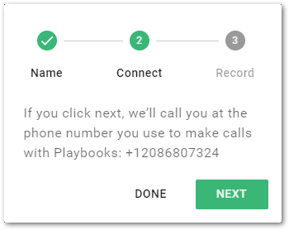
Pre-Recorded Voicemails
Navigate to: Menu > Settings > Phone

Slide 62
Using Pre-Recorded Voicemail
Find the proper message, wait for the beep, and select it
Playbooks automatically disconnects you from the call and you can move on to the next record
When the person’s message is playing click here
Pre-recorded voicemail templates are a 2 step process

Slide 63
Record Activities Feed
Add Notes to the Activity Feed and they sync to Salesforce
Notes sync to the Description field of the Lead/Account/Contact

Slide 64
Record Activities Feed
Listen to recorded calls or see the emails that you have sent

Slide 65
Record Activities Feed
See the emails that you have sent

Slide 66
Prospecting with Playbooks

Slide 67
Prospecting Scenario 1
It’s Monday morning and you have set aside 60 minutes for prospecting. Today’s focus is on a specific group of leads and you already have them loaded into a Play. You want to focus on only those leads that you have added to this Play, so you need to filter for that Play.

Slide 68
Prospecting Scenario 1
Access your task list
You can click here from any place in Playbooks

Slide 69
Prospecting Scenario 1
Choose how your tasks are sorted

Slide 70
Prospecting Scenario 1
Select a certain Play
Don’t call people too early (or too late)!
Now filter them to the tasks that you want to prioritize

Slide 71
Pre Call Motion
Most Sellers are spending too much time in pre-call research
Varied connect rate during prospecting leads to wasted effort
Analysis Paralysis – Too Much Information
Inefficiencies of moving between applications
Relational Sales Motion
Use Notable Events, Insights and LinkedIn Sales Navigator in Playbooks
Spend 3 minutes on Research
Find 3 pertinent conversation starters with a prospect
3 x 3

Slide 72
Insights
General info about the prospects company
See this person on LinkedIn with Sales Navigator
Company News

Slide 73
Sales Navigator in Playbooks
Open Sales Navigator in Playbooks by clicking on VIEW INSIGHTS
Make sure you click on “Sales Navigator” and you’ll see your prospect’s information
It is required that you have a Sales Navigator Team license to see it in Playbooks

Slide 74
Prospecting Scenario 2
While on a call in a Play, you identify a potential sale you’d like to add to the forecast. You’ll need to make the play successful, then create the opportunity in the CRM.

Slide 75
Prospecting Scenario 2
Disposition the call as “Correct Contact”
Add appropriate notes
Mark Play Successful
Follow standard Salesforce process for deal progression/lead conversion

Slide 76
Prospecting Scenario 3
While on a call in a Play, the customer does not have a known project or need identified. The person was a Lead record in Salesforce. We’ll close out the prospecting motion in Playbooks, then update the lead in Salesforce so future sales leads are refined.

Slide 77
Prospecting Scenario 3
Disposition the call as “Correct Contact”
Add appropriate notes
Remove the prospect from the Play
Update the Lead Status in Salesforce to the appropriate value
Remove the Prospect from Playbooks

Slide 78
Prospecting Scenario 4
You receive an email or return phone call from a potential customer. Whether its identifying an Opportunity, or ending the Play, you should close out the effort in Playbooks and Salesforce.

Slide 79
Prospecting Scenario 4
Interested
Search for the Person in Salesforce
Click “View in Playbooks”
Mark Play Successful
Convert Lead to Opportunity/Contact
Not Interested
Search for the Person in Salesforce
Update the Lead Status to appropriate rejected status
Click “View in Playbooks”
Click on Play name and remove from playbooks

Slide 80
Next Steps
Add 10-15 leads to Playbooks
Complete the first step for all the people in your Playbook
Record some voicemail templates
Rinse and repeat if time allows
Tomorrow: Continue to work through Playbooks. Follow up Play steps may be due.

Slide 81
ISSUE RESOLUTION
Review the handouts from training sessions or help site
Ask a peer/team member
Ask a manager or Sales Operations for further assistance
1
2
3
Consult
handouts
Ask your
manager
Ask Speed Team Member

Slide 82
On Demand Help
Chat directly with Support
Find an answer from the Playbooks Help Site

Slide 83
Thank you

