Slide 1
Playbooks for SFDC Manager Training
November 2019

Slide 2
AGENDA
Call monitoring
Playbooks reports
Current team performance | review reports in SFDC
Email templates & Play strategy
Best practices to drive improved performance
Recommended support plan

Slide 3
Call Monitoring

Slide 4
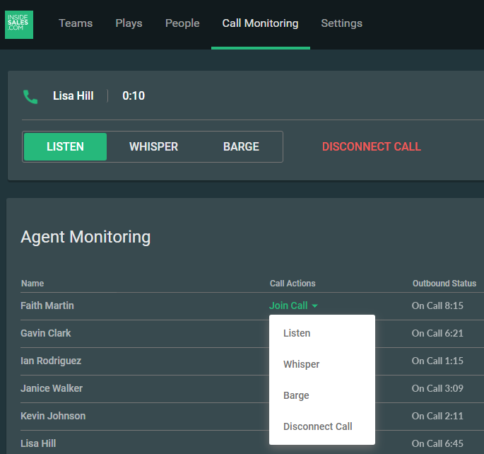
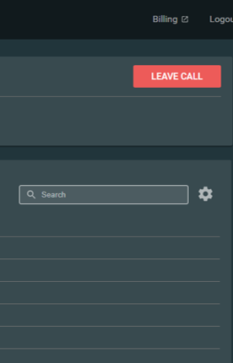
Call Monitoring
One of the most effective ways you can help you team is by reviewing their actual performance, and pro-actively coaching in real-time
Using Call Monitoring:
Launch the Playbooks Manager web-app and click the "Call Monitoring" tab
Ensure your phone number is entered in Call Monitor settings (the gear next to search)
Click Join Call next to a rep who is actively on a call, select the desired monitoring action
Playbooks will call you at the number you entered in Call Monitor Settings to begin monitoring
Managers can switch between Listen, Whisper, and Barge as needed.

Slide 5
Playbooks Reports

Slide 6
Playbooks SFDC Reports
Calls by rep today
Talk time
Correct contact by time of day
Call result detailed view
Call Recordings
Play enrollment status

Slide 7
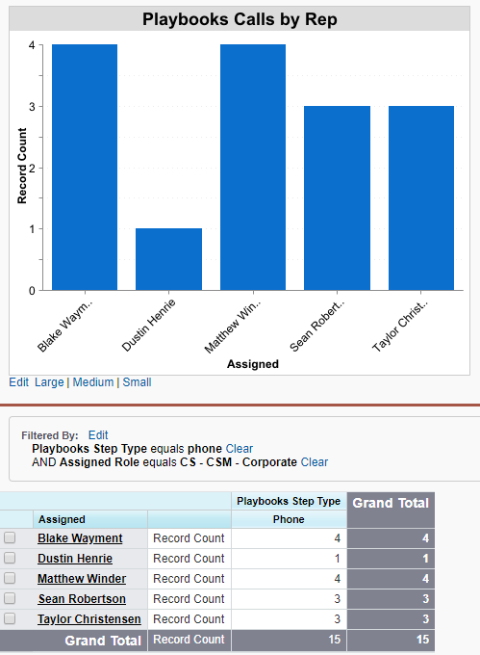
Playbooks Calls by Rep
The first step to hitting your number is ensuring consistent daily effort from the team. The fundamental measurement of effort is dials per day
How many calls are made by my team each day/week?

Slide 8
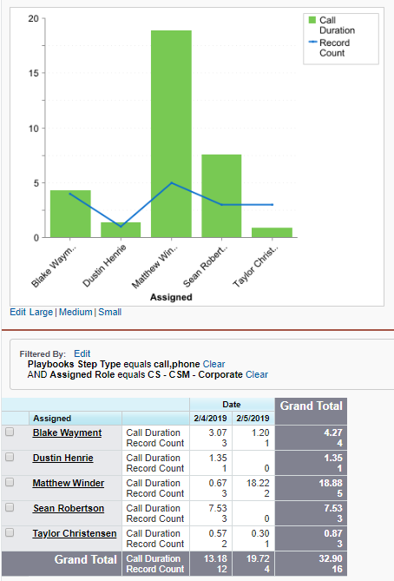
Talk Time by Rep
Talk time is a fundamental measurement of:
Rep effort
Properly structured schedule
Lead quality
Rep effectiveness / preparation / selling ability
How much time have my reps actually been speaking with prospects?

Slide 9
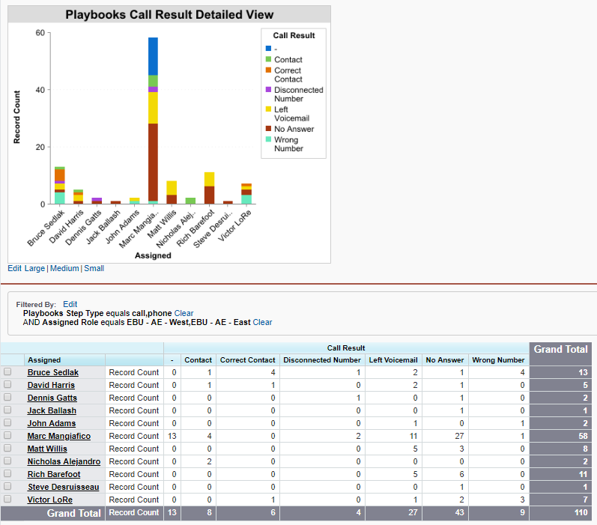
Call Result Detailed View
When launching Playbooks, an even distribution of call dispositions indicates proper use of the tool
After launch, knowing the results of your reps’ calls is an indicator of rep effectiveness and lead quality
What is the outcome of our phone calls?

Slide 10
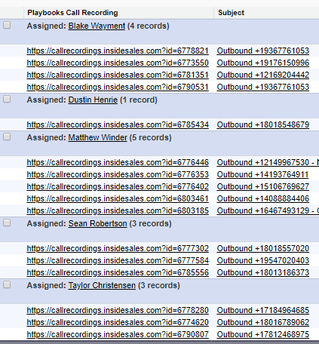
Playbooks Call Recordings
Call Recordings improve rep ability when used in the following ways:
Rep self-evaluation
Team training
Manager 1:1 coaching
Simply click on a link to download the recording

Slide 11
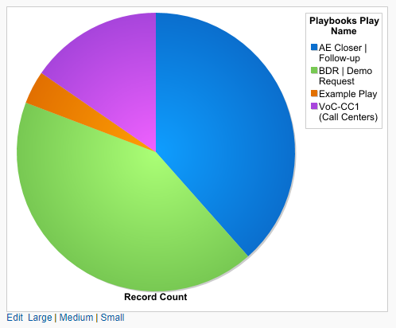
Play Enrollment Status by Play
Plays are critical to building healthy pipeline
What plays is my team focused on currently?
Are we focusing our prospecting efforts in the right areas?
What is the Play Status for the records currently enrolled in a Play?

Slide 12
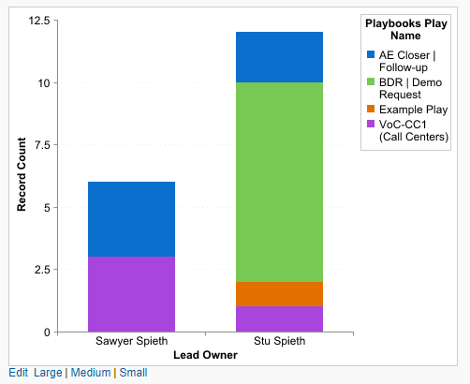
Play Enrollment Status by Rep
Plays are critical to building healthy pipeline
Is my team actually using the plays that we’ve given them?
How many records has each rep enrolled into a play?

Slide 13
Now Let’s review the reports in your CRM!

Slide 14
Email Template & Play Strategy

Slide 15
Email Template & Play Strategy
What questions do you have about email templates?
Plays?
What feedback have you received from reps since they started using Plays?
Q&A

Slide 16
Best Practices to drive improved performance
Gamification Program

Slide 17
What is Gamification?

Slide 18
Gamification:
The application of game principles and design to sales to improve rep motivation and productivity.
Points
Competition
Team-work
Time constraints
Recognition
Rewards

Slide 19
Why Gamification Works
Improves sales performance by engaging reps, providing visibility to reps and managers, and creating a culture of praise.

Slide 20
Example Gamification Strategy

Slide 21
Gamification Calendar
Sun | Mon | Tue | Wed | Thu | Fri | Sat
 | 1 | 2 | 3 | 4 | 5 | 6
7 | 8 | 9 | 10 | 11 | 12 | 13
14 | 15 | 16 | 17 | 18 | 19 | 20
21 | 22 | 23 | 24 | 25 | 26 | 27
28 | 29 | 30 | 31 | Example Month
Self-source prospecting competition
Dials competition
Dials & Talk Time points competition
Dials & Opps points competition

Slide 22
Example Gamification Strategy
Weekly Focus | Day | Games/Competitions
Week 1: Lead Acquisition | Mon | Self-source Prospecting: Reps must source at least 10 leads per day, adding new records into Playbooks. Team members will support each other to make sure everyone meets the goal. | Daily Power Hour
 | Tues
 | Wed
 | Thu
 | Fri
Week 2: Effort & Productivity | Mon | Playbooks Activities: Option 1: The top power hour activity generator each day can enter their name in a drawing for movie tickets. Option 2: All or nothing! If every rep reaches at least 85 activities a day for the whole week, everyone on the team receives [insert awesome prize]. Everyone must make it. If one person doesn’t reach the goal, no one gets the [insert awesome prize].
 | Tues
 | Wed
 | Thu
 | Fri
Week 3: Quality Conversations | Mon | Talk Time: Winners are those in the top 3 for highest talk time.
 | Tues
 | Wed
 | Thu
 | Fri
Weeks 3-4: Opportunity Creation | Mon | Opportunity + Dialing Machine: (This challenge actually begins week 3) Winners are the top 3 reps who create the most opportunities in a two-week time-frame, but in order to qualify as a winner, the rep must have made at least 100 dials each of the previous weeks.
 | Tues
 | Wed
 | Thu
 | Fri

Slide 23
Baseline & Lift

Slide 24
Baseline & Lift
Baseline |  | Target
Actual
Daily Dials
Connects
Talk Time
Appointments
Opps Created
Notes:
POOF = Pipeline Outside Of Funnel

Slide 25
Recommended Support Plan

Slide 26
Recommended Playbooks Support plan
User
Peer
Manager
Sales Ops
Case
XANT Support
CXM
Available at all times: http://www.helpcenter.xant.ai/

Slide 27
THANK YOU

